Slide 1
Partnerships for Early Childhood
Development: Meeting # 1
Thursday, May 25, 2017
9:00am – 2:00pm
Notes:
Welcome from Jim Tallon, President and CEO of the United Hospital Fund. Call on Rachael Pine, Altman Foundation, and Rachel Pardoe from The New York Community Trust.

Slide 2
Welcome & Warm Up

Slide 3
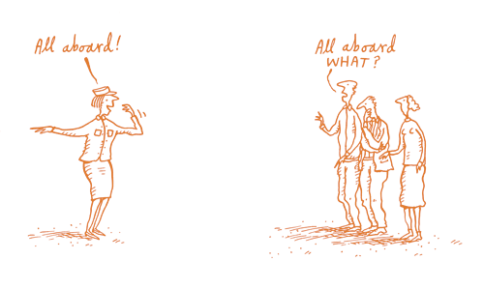
You Might Be Wondering…
Why am I here?
Who else is here?
What are we going to do?
How are we going to do it?
Notes:
Thank you Jim. Good morning! It’s great to see all of you. I’m going to be your MC for the day. Before we jump into the heart of our work for the day, I thought I would set the stage for today’s discussions.

Slide 4
Big Picture Goal
Initiate, expand or strengthen clinical-community partnerships focused on promoting early childhood development by March 2018, in order to ensure that all 560,000 children in NYC under the age of 5 are healthy and thriving.
Notes:
We always start with the result we are working towards for kids, and for us at the Children’s Health Initiative that is to ensure that all 560,000 children under the age of 5 in the City are healthy and socially-emotionally well. A key strategy to achieving that goal is the work you are doing – building, strengthening, or expanding connections between primary care and community based services for families.

Slide 5
Goals for the Day
Partner teams:
1. Engage in joint learning and planning.
Use lessons learned to strengthen
their own work plans.
Identify next steps to move their
projects forward.
Notes:
The day is designed with a few simple goals in mind:
we know it’s a challenge to find time to be with one another, so we want everyone to have the chance to engage in joint learning and planning.
We hope each team leaves here with at least one new idea that they can apply to their work;
and we want everyone to leave with some concrete next steps they can take to move their work forward.
MATERIALS: On the left side of your folder you will find a next steps form. As ideas for next steps come to you through out the day, let me call Matlin about this issue or let’s schedule a team meeting to call about x issue, we encourage you to jot down those ideas. We can scan them for anyone who wants to share with their teams.

Slide 6
PECD Teams
Notes:
We have an exceptional group gathered in this room. Breaking down siloes, creating better systems of care for families – that’s incredible tough work. But we think the expertise is in this room and we hope you view this next year as a chance to tap into this network. We’ve color coded your name tags so you can see who is with each team.
MATERIALS: this is also in your packet along with a contact list of everyone associated with these projects.

Slide 7
Staff

UHF
Suzanne Brundage, Program Director
Matlin Gilman, Health Policy Analyst
Gabriela Groenke, Executive & Program Assistant
Deborah Halper, VP for Education & Program Initiatives
Chad Shearer, VP for Policy
Lee Partridge, Advisor
Altman Foundation
Rachael Pine, Senior Program Officer
The New York Community Trust
Rachel Pardoe, Program Officer
NYU
Carolyn Berry, PhD
Kelly Quinn, PhD
Maggie Paul, MS, PhD candidate
Notes:
Quite a few staff in the room to support you throughout the day. First want to thank and acknowledge our partners in this effort, Rachael Pine from the Altman Foundation, and Rachel Pardoe and Irfan Hasan from the New York Community Trust.
UHF staff –
*special thanks to Matlin*
NYU staff --
Dr Benard Dreyer is Chair of our Learning Collaborative. Other obligations precluded him from joining us today although he very much wishes he could be here. But he’s been closely involved in the planning of today’s session and wishes everyone great success as they launch their projects.

Slide 8
Agenda
Welcome & Warm Up
Presentation & Discussion: Child Well-Being in New York City
Team Gallery Walk: Project Review
Discussion of Observations
Lunch
Evaluation Framework Presentation
Team Working Session
Closing & Next Steps
Notes:
Busy day ahead:
When we were putting together the agenda for the day we thought this first meeting would be a good opportunity to collectively take a look at children in the City, the range of risks they are facing, where those risks are concentrated, and what we know and don’t know about why families may or may not be accessing assets in those communities. No one better to lead us in that discussion than our friend Jennifer March, Executive Director of the Citizen’s Committee for Children.
We will then spend the rest of the morning learning about one another’s projects and exploring some common issues and strategies.
We’ll break for lunch – give people an opportunity to network with one another—then begin a conversation with Carolyn Berry and her team at NYU about the common evaluation and how we propose measuring our collective progress toward connecting children to needed services.
Finally we’ll end the day with team planning time and we’ll offer some tools to assist with that work. Technical assistance also available then.

Slide 9
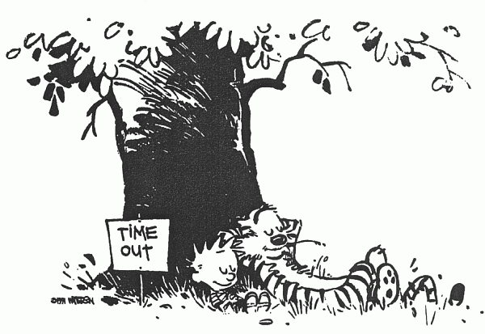
Housekeeping
Treat the day like a mini-sabbatical:
Relax, learn, engage.
2. Take breaks as needed.
Focus on the desired result for
children & families.
We’re all friends here.
5. #PECD
Notes:
END at 9:25
Finally, just a few thoughts on how we run things at UHF. We know it’s hard to take 5, 6 hours out of the work day – we appreciate that you are here, and we hope you take the day as a mini-sabbatical, as a chance to step back from the busyness of things, see things from a new perspective, perhaps engage with some folks you normally wouldn’t be able to. This is particularly important because there’s so much health care and social service organizations have to offer one another, and a lot to learn
Take breaks freely – there are bathrooms down the hall, plenty of coffee and food throughout the day. Get up to stretch your legs.
Our President’s favorite: We’re all friends here. You can be candid and honest in this space. Respectfully challenging one another is ok. We might call on you throughout the day to prompt discussion and we know you won’t mind if we do that.
For anyone who might be tweeting, we encourage you to use the hashtag #PECD.
And finally, before we get started I want to let you know we are recording this session just for internal note keeping. The file won’t be posted or shared but if anyone has concerns let us know and we can stop the recording.

Slide 10
Let’s Get Started
Gather with your project team
Imagine it is May 2022.
The New York Times publishes
an article on what your project
has achieved.
What’s the headline? Write it down.
Notes:
END at 9:30
So let’s get started. Much of the day we are going to be very focused on the details of your PECD projects. Before we do that, we want to encourage everyone to look out at the horizon and set a vision for what they hope to accomplish, and to get your creative juices flowing. Imagine it is 2022. You and your partners have been working together for five years. The NY Times writes a feature on your work – what’s the headline?
You have 5 minutes, and can only have one headline per team. Write the headline down on the index card in your basket – and when you are done raise it high. We are going to collect them to share with everyone.

Slide 11
Child Well-Being in New York City
Jennifer March, PhD
Executive Director
Citizens’ Committee for Children
Notes:
Excited to take a look at those headlines. Hope you will keep those aspirations in mind as we move through the day. We’re going to transition now into a deep dive into the question of “what do we know about child wellbeing in New York”? I’m going to invite my colleague Matlin Gilman up to introduce Jennifer March and Hetali Jokhakar.
[Matlin does intro.]

Slide 12
Discussion
Notes:
The last question raised by Jen on slide 29 is the big issue for me: If a community has adequate resources to address risks, are they being accessed? Why or why not? That seems critical to the work of this group. How would folks in this room respond to that question?
What strategies are being used by the organizations in this room to engage families and understand what might be preventing them from accessing resources? – focus groups, advisory boards, etc. What have they learned?
Family fear due to immigration concerns was surfaced in almost all of the gallery walks. Is that influencing or changing how organizations are approaching their work? How do you build trust?
If any follow up steps came to you during this conversation, be sure to write them down on your next steps form.
END at 10:15

Slide 13
Team Gallery Walk: Project Review

Slide 14
Gallery Walk Guide

1. With your project team spend
5 minutes at each poster.
2. Look for common strategies
and challenges, strategies you
want to know more about, or
strategies you want to adopt.
3. Move to the next poster when
the bell rings.
Notes:
Now is our opportunity to take a much closer look at all of the PECD projects. You’ll notice posters around the room. We are calling this a gallery walk. With your team you will spend 5 minutes at each poster.
A few things to keep in mind:
We know it’s a lot of information. We’ll share the slides with everyone afterwards.
Focus on learning what others are doing AND the insights your own teammates have to offer.
Reflect on how you can strengthen your own strategy – bring a notepad and jot down new ideas and questions as you go.
Also think about the themes from the last discussion about why some families are not connecting to community resources. Are these barriers acknowledged by teams? Are there approaches to resolving those barriers in the workplans?

Slide 15
Gallery Walk Navigation
Notes:
You also have this sheet in your folder – it tells you which poster to begin at. Spend 5 minutes at that poster, and when the bell rings move to the next poster. We’ll have staff posted around to help you navigate.

Slide 16
Gallery Walk Observations
Notes:
1.

Slide 17
Discussion
Notes:
We have a few minutes for discussion. What we want to tease out of this session are the strategies you found particularly important – those activities that are essential for success – and particularly interesting or compelling strategies that maybe you hadn’t thought of before.
To get us started, I want to turn to Abraham Jones. Abraham, you’re executive director of the Claremont Neighborhood Center, the focal point of the Claremont Healthy Village Initiative. An extraordinary example of cross-sector partnership. Looking at the gallery assignments, what strategies did you see for building new relationships across settings? What tips do you have for those in this room who are starting new partnerships?
- Dodi Meyer
(2) I want to bring in more of the CBO perspective: what strategies were missing from your vantage point? What activities did you see that were important to you?
- Rachel Schwartz
(3) Information exchange and technology infrastructure – need for some of these digital enablers to aid in referral and information exchange. Some knotty issues involved. First want to turn to Omalara Uwemedimo and her team who mentioned some tools they are using (HITE - Health Information Tool for Empowerment (HITE)- and the TEN enabler expansion).
(4) Anyone see strategies or new ideas they want to incorporate into their work? Any strategies they want to lift up for the group?

Slide 18
Lunch
Notes:
Before we break, I want to invite up Rachel Pardoe of The New York Community Trust. Some teams in here have a grant from NYCT – not all do. Rachel has an announcement about grant reporting.
30 minute break for lunch. Buffet style outside. We encourage you to mix it up, follow up with a particular team that you might have noticed during the gallery walk.

Slide 19
Partnerships for Early Childhood development Cross-cutting evaluation
PECD Learning Collaborative Meeting
May 25, 2017
Notes:
Debbie does intro

Slide 20
Evaluation Team and Tasks
Carolyn Berry, Maggie Paul, Kelly Quinn
Provide overarching PECD logic model and evaluation framework
Help 11 grantees individualize their evaluation plans
Identify common metrics for processes and outcomes involved in screenings, referrals, and closing the loop with families and between partners
Provide technical assistance to the group and individual grantees through the learning collaborative and meetings

Slide 21
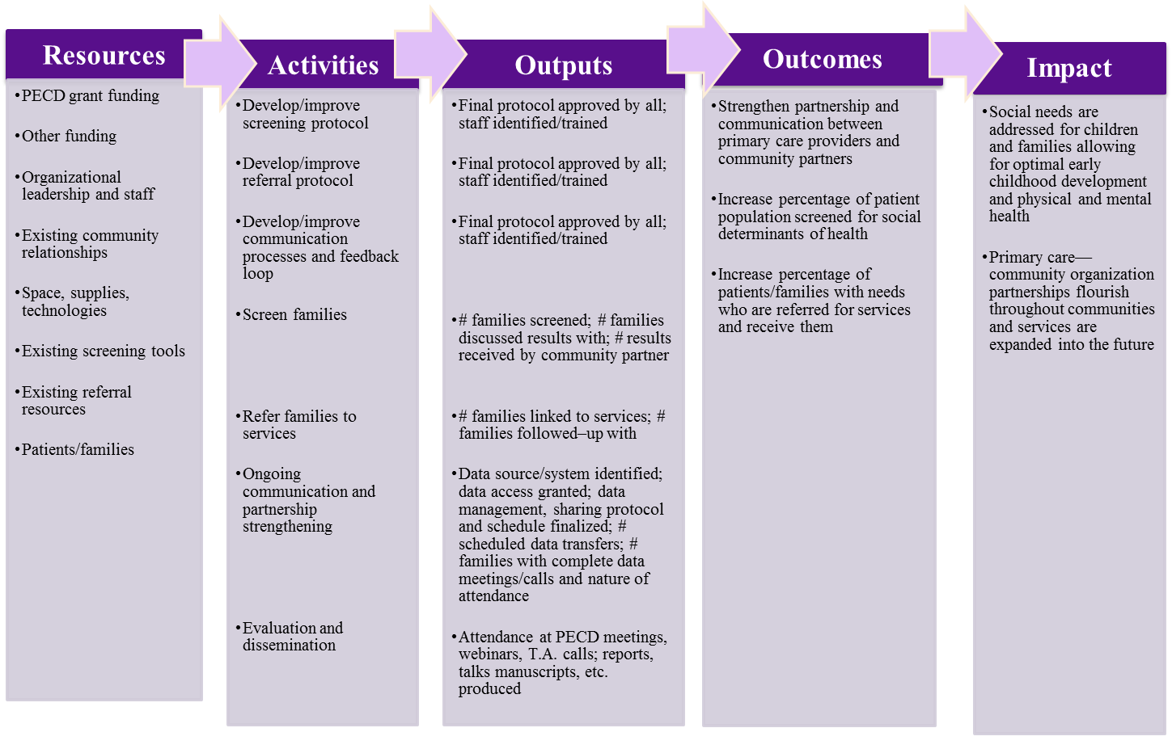
PECD Overarching Logic Model
→
→
→
→
→
→
→

Slide 22
Overarching Evaluation Framework
Monitor and evaluate 4 main proximal outcomes for PECD
Screening for social determinants of health
Referring children/families with needs to resources and services
Closing the loop through communication between community partner and primary care provider
Strengthening the primary care--community organization partnerships

Slide 23
Screening
Identify target population and denominator for measuring prevalence
Collecting and managing screening data – who, how, when?
Are data available via EHR? Who on team has access and expertise?
What tracking exists?
What additional tracking will we need?
Sharing screening data with family and community partner – who, how, when?
How will the partners transmit/share screening information?
How will confidentiality be maintained?

Slide 24
Referring Children/Families with Needs
Who will receive screening data at community organization?
What data system will be used by community organization to document referrals made, receipt of services by families, follow-up if needed?
How will referral information be collected and shared for evaluation purposes?
Who has data access and expertise?

Slide 25
Closing Referral Process
Sharing referral “results” with primary care providers for better ongoing care of children/families
Who, how, when?
Documenting closure of feedback loop for evaluation purposes
Who, how, when?

Slide 26
Ongoing Strengthening of Partnership
How to measure communication and collaboration during this initiative and in the future?
Consider qualitative and quantitative measures
Consider measures of member satisfaction at baseline (or soon) and into future

Slide 27
Next Steps in Evaluation for Grantees
Refine individual logic models (with community partners!)
Develop site-specific evaluation framework
Select specific process and outcome measures
Decide on data systems, entry and management protocols, and timing of data transfers
Request evaluation technical assistance as needed
Stay tuned for future learning collaborative on evaluation

Slide 28
Notes:
END at 12:45

Slide 29
Team Working Session

Slide 30
Team Working Session Guide
Notes:
Use this time together as a chance to look holistically at your project. What you focus on how much work you have already done together and where you are in your project activities.
If you haven’t already you will want to develop a shared vision of success and discuss how you are going to work together. The Aim worksheet can help with that.
You might want to collectively review the activities and changes you plan on implementing, in light of today’s conversations. We’ve included each team’s logic model at their table to help with that.
3. A third option could be mapping the existing workflows in each partner’s organization, as a means of understanding what changes might be needed.
4. And finally, and very importantly, you can discuss how you will measure your success and when and how you will collect that data.
To support all of these conversations we have also included a resource list of questions that get at some of the sticking point teams often face.
It’s only 45 minutes so you will likely only begin these conversations. You are welcome to stay in this room after the meeting to work longer if you’d like. The NYU team and UHF staff are available for consultation and support.
Remember to write down your next steps/team commitments on the action form. We can collect the forms, scan them, and send an electronic version to you can share with team members.
END at 1:30

Slide 31
Closing and Next Steps
Notes:
Matlin is going to walk around and collect the action forms you’ve filled out. We will quickly scan them and give back your copy before you leave.

Slide 32
Synthesis
Notes:
Chad?

Slide 33
Headlines
Northwell & The Child Center
Of NY Partnership Proves
Supporting Families Leads to
Sustainable Gains in Child
Development
Record High
Literacy Rates
In the South Bronx
Finally, Healthcare
& Social Services
Fully Integrated!
Record Number of
Bronx Preschoolers
Receiving Services
St. John’s Episcopal
Cares About
COMMUNITY.
We are Connected.
No Family Left Hungry in Coney
Island!
Health Bucks Buy Healthier
Children!

Slide 34
Headlines
Social Services Clinical
Partnership Working
Together to Achieve
Well Being, Healthy Mind
Healthy Babies,
Healthy Family.
Queen’s Children Thrive by 2025:
A Comprehensive Wellness Model
For Primary Care
A New Rx From Your
Pediatrician: Lower East
Side Collaborative Takes
A Holistic Approach to Caring
For Families
Smile Brooklyn!
End of Food
Insecurity &
Anxiety
Sustained School Outcomes
Among Children who Received
Developmental &
Socioemotional Services in
Early Childhood

Slide 35
Reminders
Look for monthly newsletter with program
updates, resources, and news of interest
Two summer webinars:
- Partnership building
- Evaluation and Quality Improvement
Please fill out a meeting feedback survey!
Drop it in the box by the door on your way
out.
Notes:
And few reminders before you go… Teams are welcome to stay in here for another hour or so. We’ll break down the room around 4pm.

Slide 36
Contact Information
Suzanne Brundage
Program Director, Children’s Health Initiative
Matlin Gilman
Health Policy Analyst, UHF
sbrundage@ uhfnyc.org
(212) 494-0729
@suzbrundage
mgilman@ uhfnyc.org
(212) 494-0744

Slide 37
The United Hospital Fund works to build a more effective health care system for every New Yorker. An independent, nonprofit organization, we analyze public policy to inform decision-makers, find common ground among diverse stakeholders, and develop and support innovative programs that improve the quality, accessibility, affordability, and experience of patient care. For more information about UHF please visit our website at www.uhfnyc.org and follow us on Twitter.
Founded in 1913 by Benjamin Altman, the mission of the Altman Foundation is to support programs and institutions that enrich the quality of life in New York City, with a particular focus on initiatives that help individuals, families, and communities benefit from the services and opportunities that will enable them to achieve their full potential. With a focus on vulnerable populations, the Foundation awards grants in the areas of Education, Health, Strengthening Communities, and Arts and Culture. For more information about the Altman Foundation please visit our website at www.altmanfoundation.org.
The New York Community Trust is committed to promoting healthy lives, promising futures, and thriving communities for all New Yorkers. We are the community foundation for New York City, Westchester, and Long Island—with a permanent endowment dedicated to improving our region through strategic grantmaking, civic engagement, and smart giving. Through our competitive grants program, made possible with money left to us by bequest, we fund programs that improve the lives of all New Yorkers, especially those most in need. For more information on The Trust, please visit our website at www.nycommunitytrust.org and follow us on Twitter.

