Slide 1


What’s so great about PROMIS?
Dave Mitten MD
University of Rochester Medical Center Health Lab
Rochester, NY USA

Slide 2

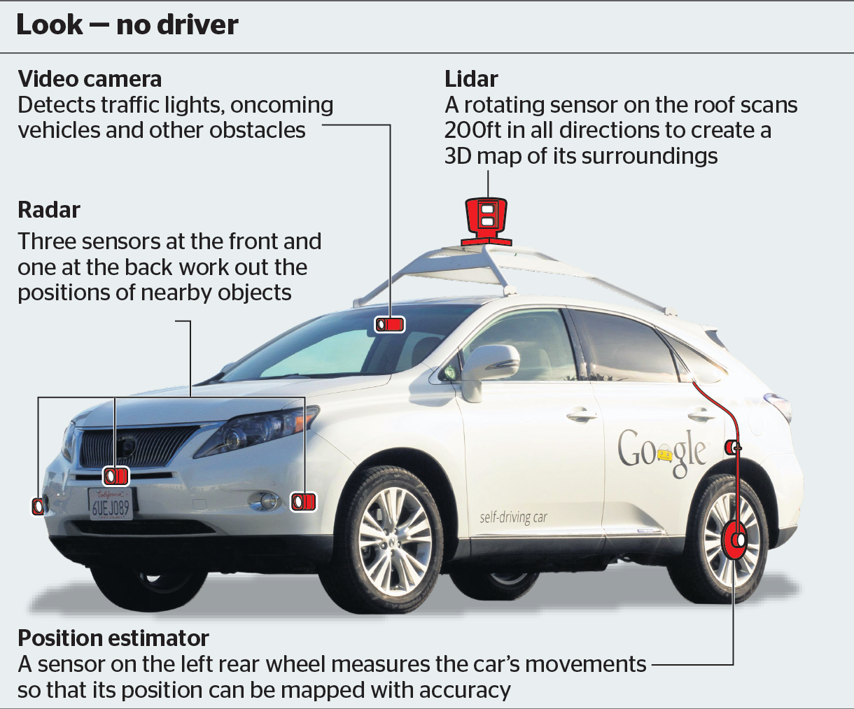

UR Health Lab: DATA Science
IBM has spent more than $4 billion buying a handful of companies with vast stores of medical data.
“A.I. machines are only as smart as the data you give them.”
John E. Kelly, who oversees IBM’s research labs and the Watson business
New York Times Oct, 17, 2016
Notes:
Can’t do data science without data. Computational power has dramatically increased.

Slide 3

  Michael E. Porter, Ph.D.-What is Value in Health Care?
  "Achieving good patient health outcomes is the fundamental purpose of health care.
  outcome measurement is perhaps the single most powerful tool in revamping the health care system.
  Yet systematic and rigorous outcome measurement remains rare or nonexistent in most settings. "

Slide 4
Why Strategy Matters Now
Michael E. Porter, Ph.D., and Thomas H. Lee, M.D.
N Engl J Med 2015; 372:1681-1684
“Providers that organize themselves to improve outcomes and become more efficient in doing so will be rewarded with patients, professional satisfaction, and financial success. They will prosper even if fee-for-service reimbursement lingers for years, because better outcomes will attract more patients and greater efficiency will reduce copayments and improve financial margins.”

Slide 5
Background
Most common issues raised about PRO in clinical practice.
  Too hard and expensive to implement.
  It will take too long. I don’t have time.
  The iPad will get stolen.
  Patients won’t like it.
  I don’t need PRO to practice, I’m doing fine without it.

Slide 6
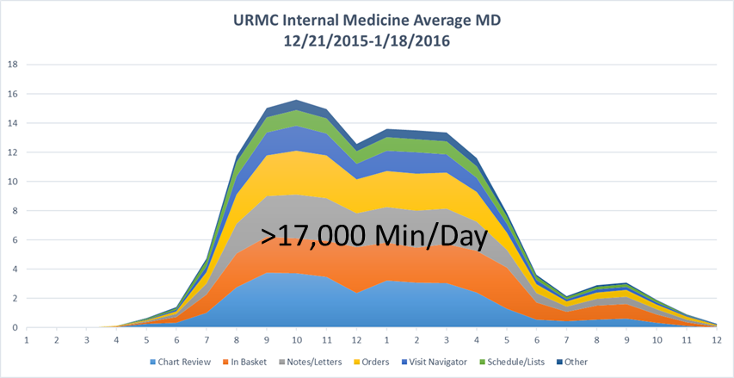
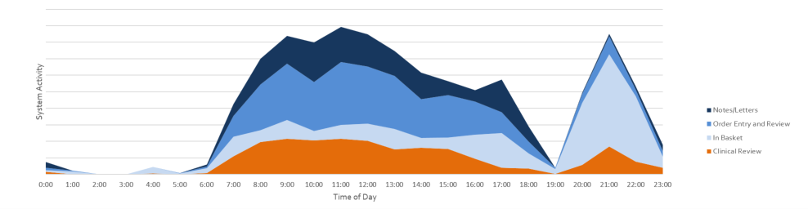
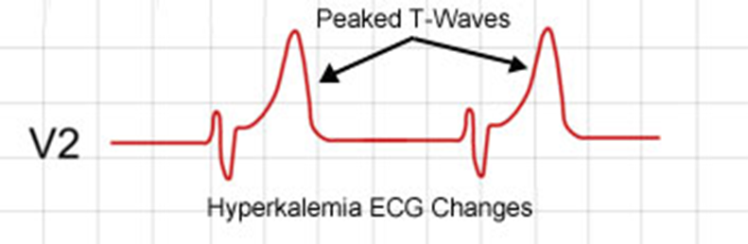
Is Primary Care Sustainable?
Hyper-InBasket-emia

Slide 7
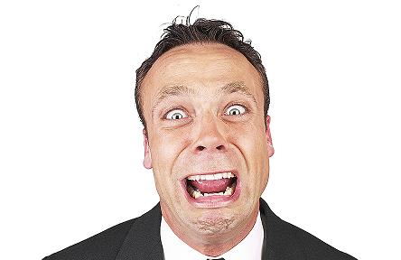
Pivotal Decisions
What Outcome Instrument to Use and How to Obtain it?

Slide 8
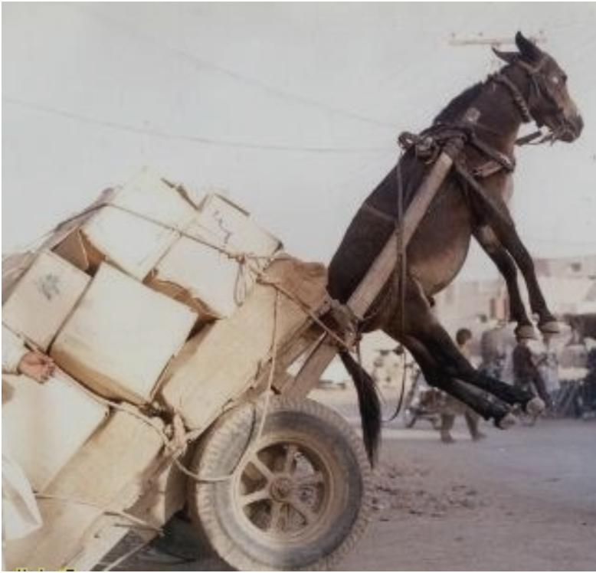

Must Have’s
Validated Instrument
Quick
Inclusive
“Not on the backs of the Clinician”
Inexpensive
Mix of domain and condition specific tools

Slide 9
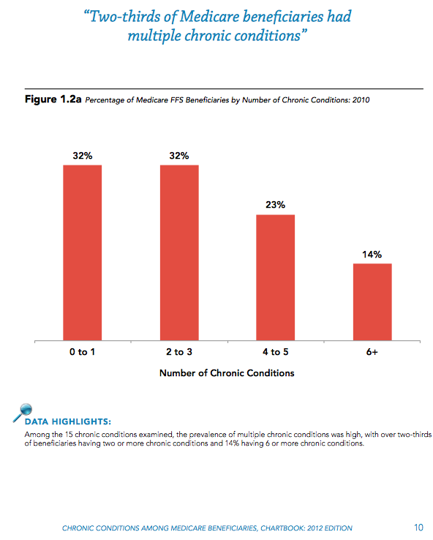
Disease Specific PRO Will Not Work
69%

Slide 10
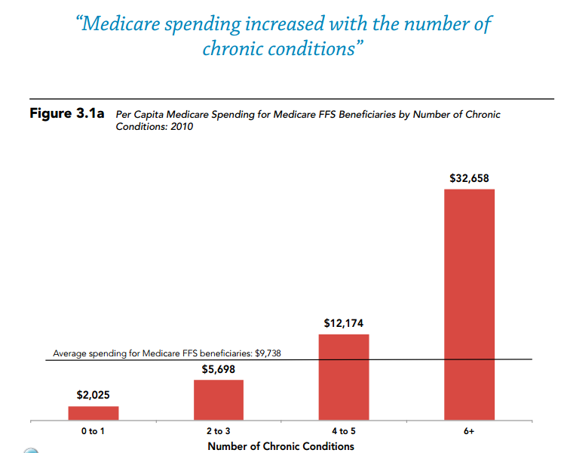

Cost Increases With Number of Chronic Conditions
CMS Chartbook: 2012

Slide 11
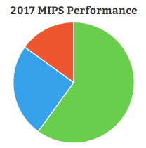
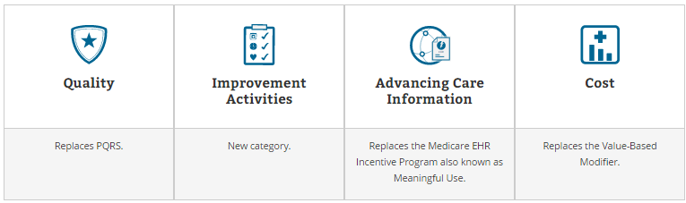
CMS
MACRA
QPP
Alternative Payment Models
90%
MIPS
Merit-based Incentive Payment System
60%
15%
25%
Replaces PQRS
New Category
Replaces MU
Replaces Value-Based Modifier

Slide 12
MIPS
Merit-based Incentive Payment System
60%
15%
25%
Replaces PQRS
New Category
Replaces MU
Replaces Value-Based Modifier
Most participants: Attest that you completed up to 4 improvement activities for a minimum of 90 days.
Participation in a QCDR, demonstrating performance of activities for promoting use of patient-reported outcome (PRO) tools and corresponding collection of PRO data (e.g., use of PQH-2 or PHQ-9 and PROMIS instruments).

Slide 13

Patient Reported Outcome Measurement Information System
  11-year, $100 million effort by NIH
Collection of questionnaires (instruments)
  Produces validated data quickly
  Computer Adaptive Test (CAT)
  Item Response Theory
Measure concepts such as pain, fatigue, physical function, depression, anxiety, and social function.
Different each time

Slide 14
Using CAT, the patient only needs to answer 4-8 questions per instrument.
Average PROMIS instrument can be given in under a minute.
Inclusive of our diverse community
  Available in multiple languages including Spanish.
  Translating to ASL
  Pediatric
Short forms are static
  PROMIS 10 and 29
  Higher standard error

Slide 15
Typical
PROMIS CAT
Wide range
High precision
Question 1
Question 2
Question 3
3
3
2
2
2
2
2
1
1
1
1
1
0
0
0
OR
- 1
- 1
- 2
- 2
- 3
- 3
low precision
small range
Questionnaire with a high precision AND a wide range

Slide 16
I felt depressed
  Never
  Rarely
  Sometimes
  Often
  Always
T-Score = 52
SE = 4
Next Best Item-I felt like a failure

Slide 17
I felt like a failure
  Never
  Rarely
  Sometimes
  Often
  Always
Next Best Item-I felt worthless
T-Score = 53
SE = 3

Slide 18
I felt worthless
  Never
  Rarely
  Sometimes
  Often
  Always
T-Score = 55
SE = 2

Slide 19
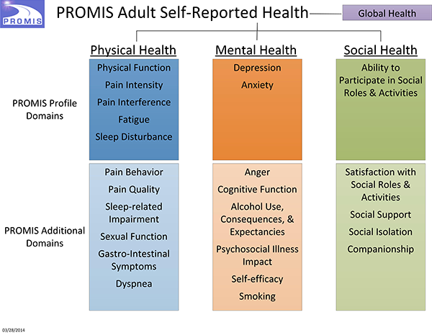
Each program chooses it own instruments.
Bio Psycho Social

Slide 20
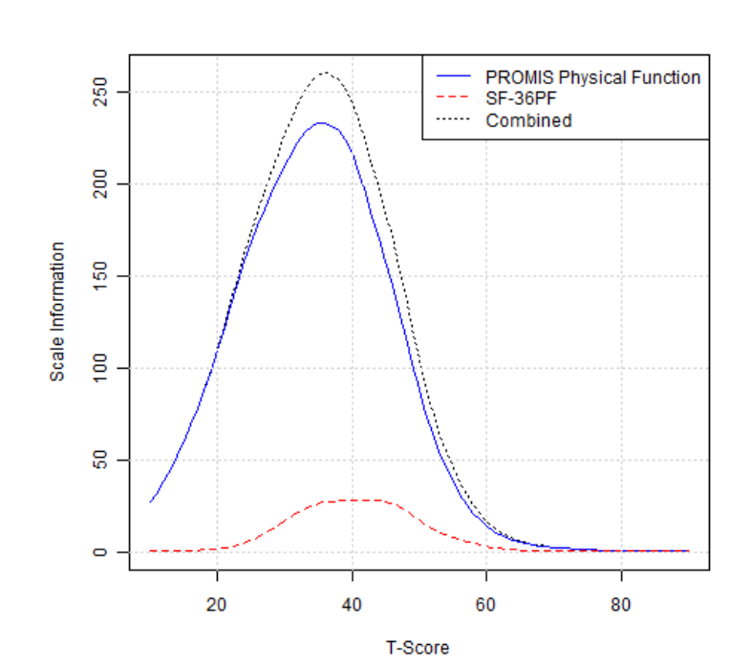
PROMIS vs SF-36PF
Floor

Slide 21
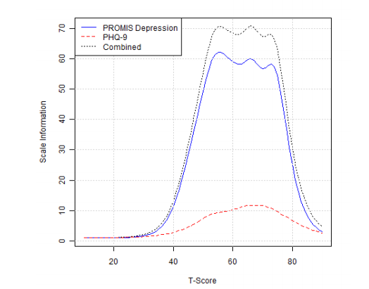
PROMIS vs PHQ-9

Slide 22
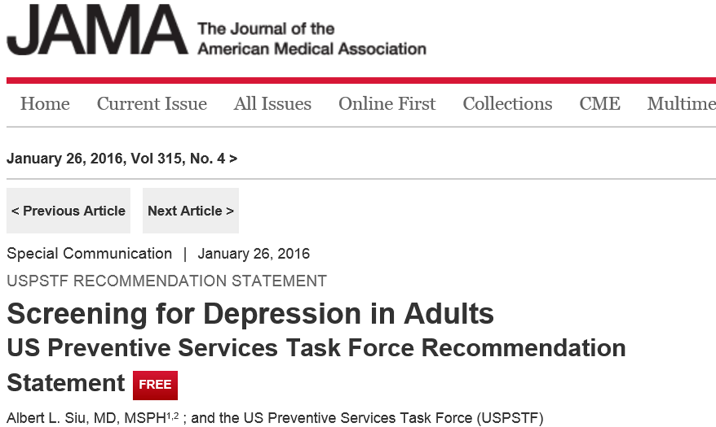
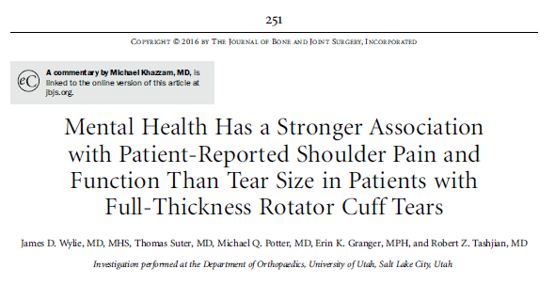

Slide 23
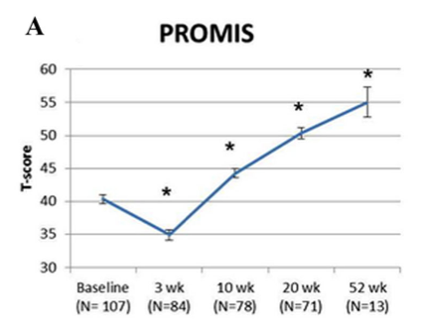
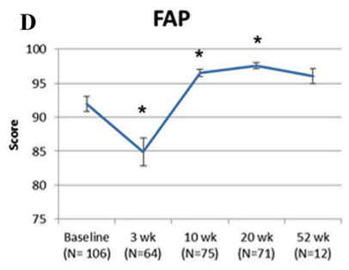
Patient Reported Outcomes:
PROMIS is Better Than Traditional Measures
One minute in waiting room with iPad
5-10 min $52,000 gait machine
Ceiling
Papuga, Kates, Schwarz, Maloney- JOR 2014

Slide 24
if you want to know
how your patients are doing…..
Just ask them

Slide 25

What if we used outcomes “backwards”?
Most diagnosis is made by taking a history and physical exam.
There is no real statistically valid history in a EHR.
Outcomes are typically used at the end to see how we did.
Can we integrate PRO into clinical workflow and EHR in real-time?

Slide 26
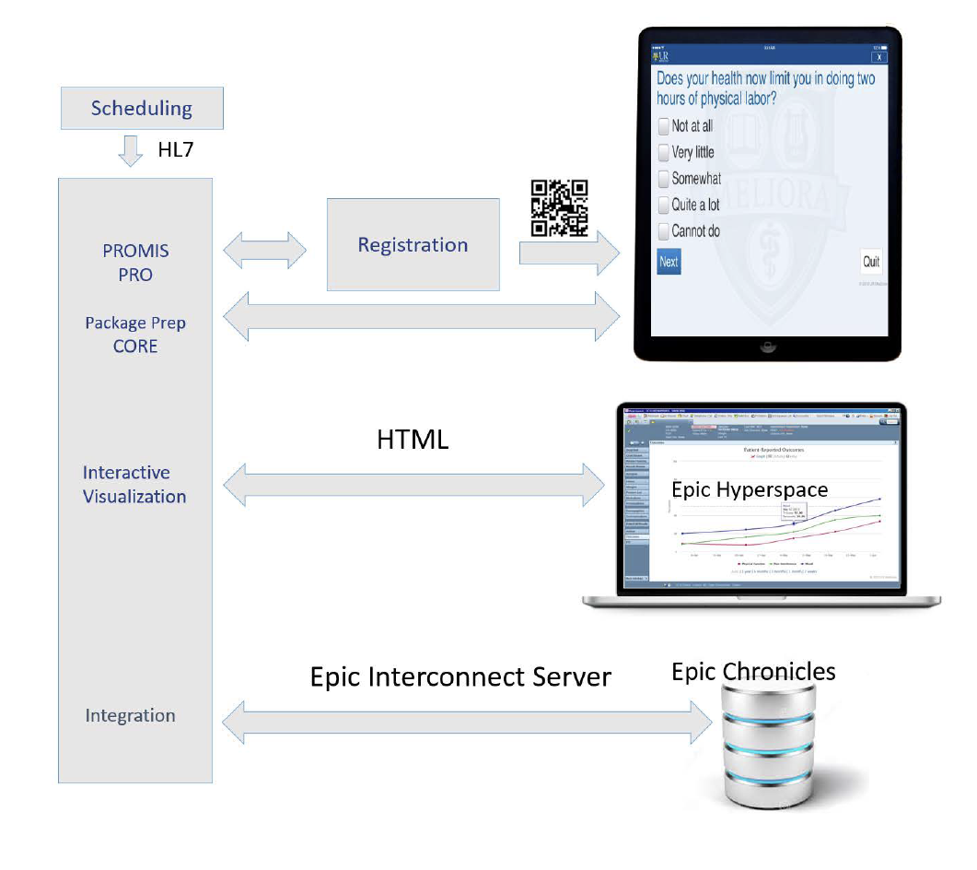

UR VOICE: Validated Outcomes In Clinical Experience

Slide 27

PROMIS

Slide 28
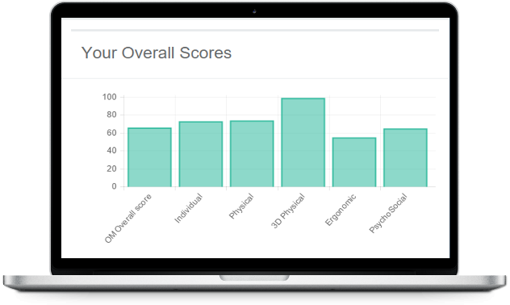
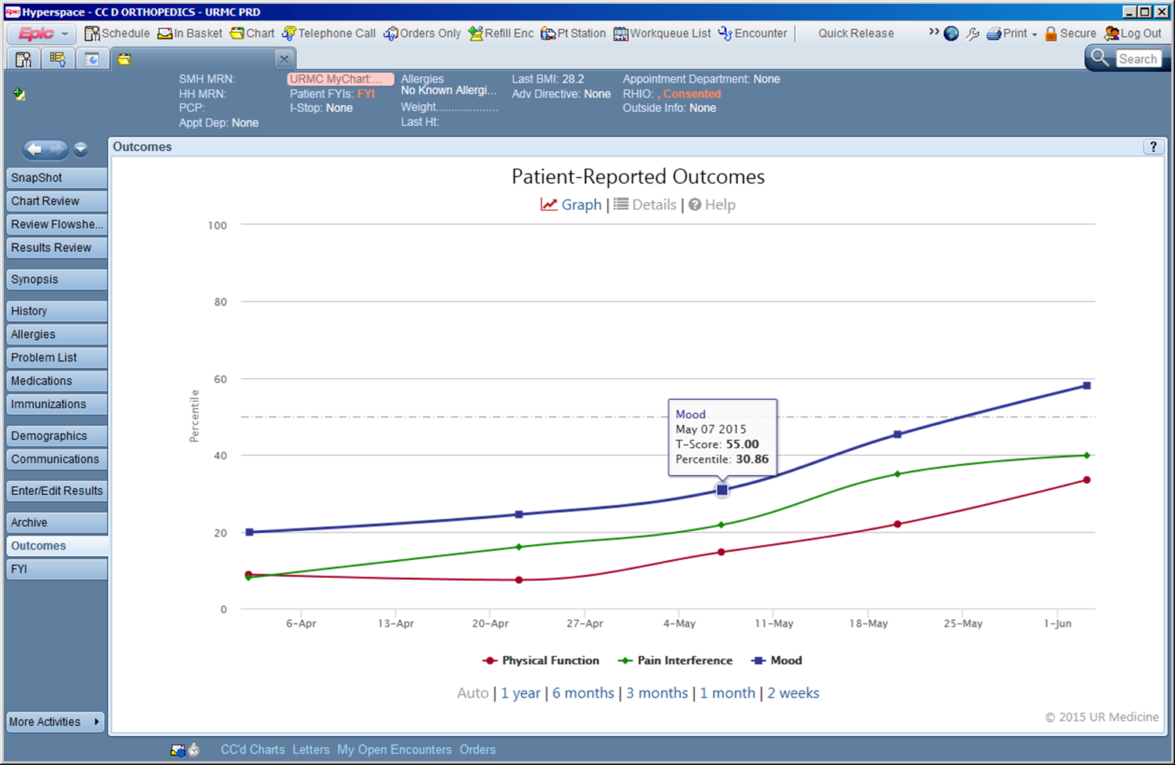

Slide 29
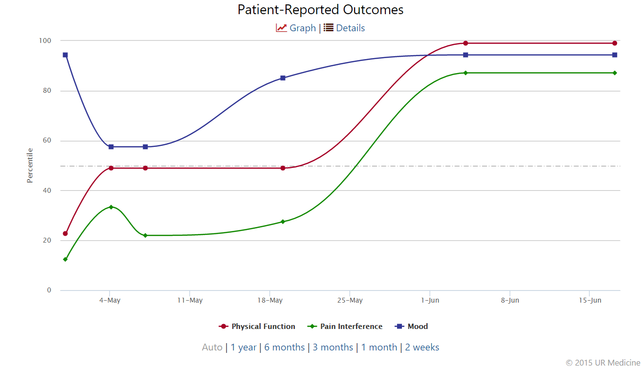

PRO Index

Slide 30
PROMIS: October 2016
100,000 Unique Patients
718K Assessments
Ave 2.4 minutes
4 million questions answered
97% administration rate
79% completion of all 3 PROMIS
Over 30 departments/divisions

Slide 31
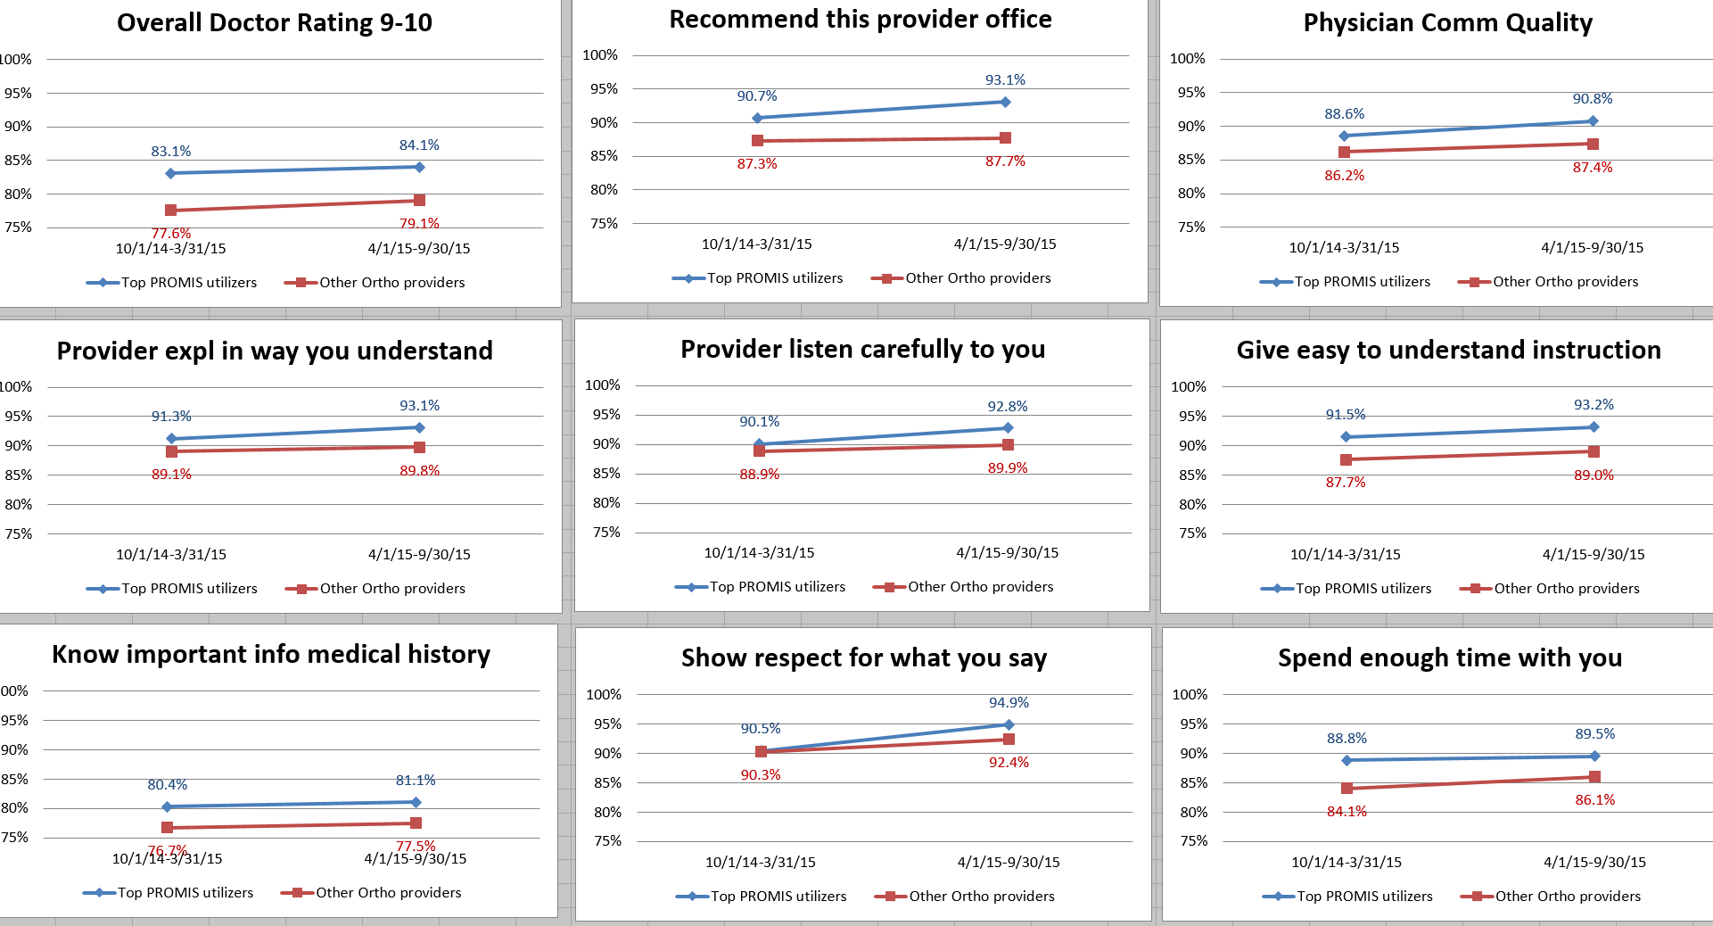
Large Scale PRO and CG-CAHPS
**
**

Slide 32

Data Analysis
Applying “big data” techniques
We’ve started already
  Early analysis shows intake PROs help predict future outcomes
  Something we need to study a lot more!
Applying these techniques in a clinical setting
  Real-time with the patient and clinician
“People like you tend to…”

Slide 33

619 ACL Surgeries
Performed by 6 Providers
(cross sectional analysis)

Slide 34
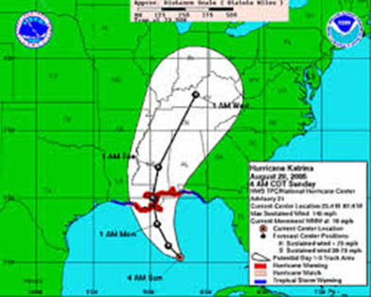
Predictive Analytics: Twinning
215 THR patients
  3 surgeons
  April-December 2015
  Minimum of 3 month f/u (mean 4.7 months)

Slide 35
Incidence of Self-Reported Depressive Symptoms in Orthopaedic Patients
47,732 patients completed all three PROMIS scores
17.5% representing nearly 8.5K patients had Dep symptoms 1-2 SD beyond mean
Subspecialty | Unique patients | t-score 60-69.9 | %1- 2 sd | t-score >70 | % >2 sd | % >1 sd
Spine | 7,604 | 1,604 | 21.0% | 335 | 4.4% | 25.5%
Trauma | 2,657 | 459 | 17.3% | 114 | 4.3% | 21.6%
Tumor | 1,612 | 231 | 14.3% | 41 | 2.5% | 16.9%
Hand | 9,825 | 1,343 | 13.7% | 270 | 2.8% | 16.4%
Foot and Ankle | 5,879 | 815 | 13.9% | 149 | 2.5% | 16.4%
Adult recon. | 4,735 | 662 | 14.0% | 104 | 2.2% | 16.2%
Sports | 15,420 | 1,834 | 11.9% | 373 | 2.4% | 14.3%
Total | 47,732 | 6,948 | 14.6% | 1,386 | 2.9% | 17.5%
Expected US Population |  |  | 13.6% |  | 2.3% | 15.9%

Slide 36
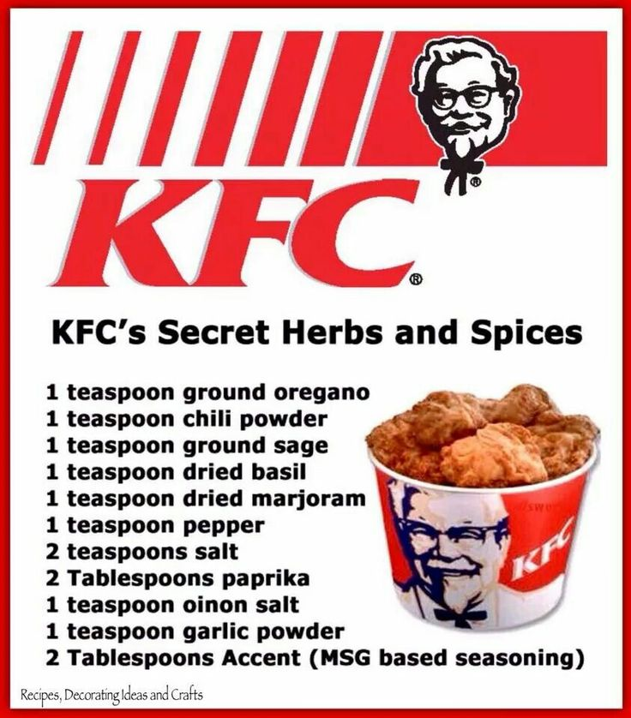
How to Get from PRO to Performance Measure
PROMIS has all the Herbs and Spices of a Performance Measure
Domain specific.
Calculation of performance score.
  Minimal detectible change = 1.96 x SEM x √2.
Target population - inclusion and exclusion criteria.
Risk adjustment methodology.

Slide 37


Physical Function - TKA
Less Function
More Function
95% Rule-in=31.4
More Function
16.1%
MCID=3.8
Less Function
13.5 %
95% Rule-out=45.1

Slide 38
Future
More Instruments
  Domain-specific + disease-specific
  More social domains
Patient-centric
  “Providing patients a voice in their healthcare”
  Shared results and decision-making
  Goal-setting and treatment targets
  Targeted interventions
  “Any patient (person), any time”
Stronger Analysis
  Machine Learning
  “Hurricane Paths”
  “People like you tend to…”

Slide 39
More Instruments
Trickier than it sounds
Patient burden is absolutely critical!
  IRT vs. Legacy Instruments
  Patients tolerate around 20-30 questions (3-4 CAT instruments)
  We limit our departments to 5 CAT instruments
  Most legacy instruments avoided due to length
The right instruments to the right patients at the right time
  Registration staff selection vs. computerized selection
  Foreign languages

Slide 40
Computer Adaptive Batteries
Use EMR Data
  Diagnoses
  Insurance
  Age
  Social determinants
Smart Testing Schedules
  e.g. collect a physical function score every week
  e.g. collect a depression score every two weeks
  e.g. collect a social score every month
Visit Type
  “Super Items” or screening instruments at initial visit
  Disease-specific instruments at follow-up

Slide 41
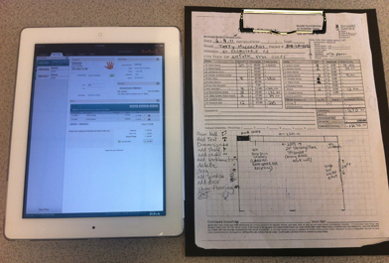
Non-PROs
Improving technology and workflow
  Intake forms
  Signatures
  Patient photos
  Patient portal signup

Slide 42
Patient-centric
Show value to the patient
  Explain the value better
  Share results with patients
Involve the patient more
  Let them help decide what’s important to them
  Set realistic goals with the patient
  Patient satisfaction
Anytime, anywhere
  Allow patients to fill out PROs any time, anywhere
  Patient portal integration
  What about non-patients?

Slide 43
Summary
Most common issues raised about PRO in clinical practice.
  Too hard and expensive to implement.
  It will take too long. I don’t have time.
  The iPad will get stolen.
  Patients won’t like it.
  I don’t need PRO to practice, I’m doing fine without it.
    What about the patient?

Slide 44
